Slide 1
Capstone
Databases
SQLite
Object Relational Mapping with PeeWee

Slide 2
Databases are everywhere
Interacting with a DB is a necessary skill
Which DB to use?
Major decision for your application
Many types of databases and data stores
Client/Server relational DB: SQLServer, MySQL, Oracle, PostgreSQL etc.
Client/Server non-relational databases: Redis, MongoDB, Cassandra…
Embedded relational DB: SQLite https://www.sqlite.org/

Slide 3
SQLite
Almost no setup needed, very minimal requirements and overhead
Unlimited number of other apps can read DB if permitted access to the device storing it
Only one writer can edit the DB at a time
Small size with smaller feature set than client/server DB
Subset of data types supported – integer, real, text, blob, null
No authentication
So less security – device storing the DB should be secured, or don't store sensitive data, or encrypt it
Supports most of the same basic of the same SQL queries you've used before
Used by many applications
Chrome/Firefox's browser cache, bookmarks
On-device database for iOS/Android apps
Boeing airplanes

Slide 4
sqlite3 is part of the python standard library
If you want to use another database, you'll need to install the driver for that library
Python supports SQLServer, MySQL, PostgresSQL, MongoDB, etc....

Slide 5
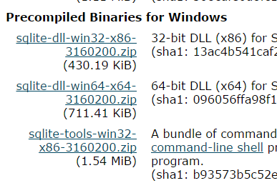
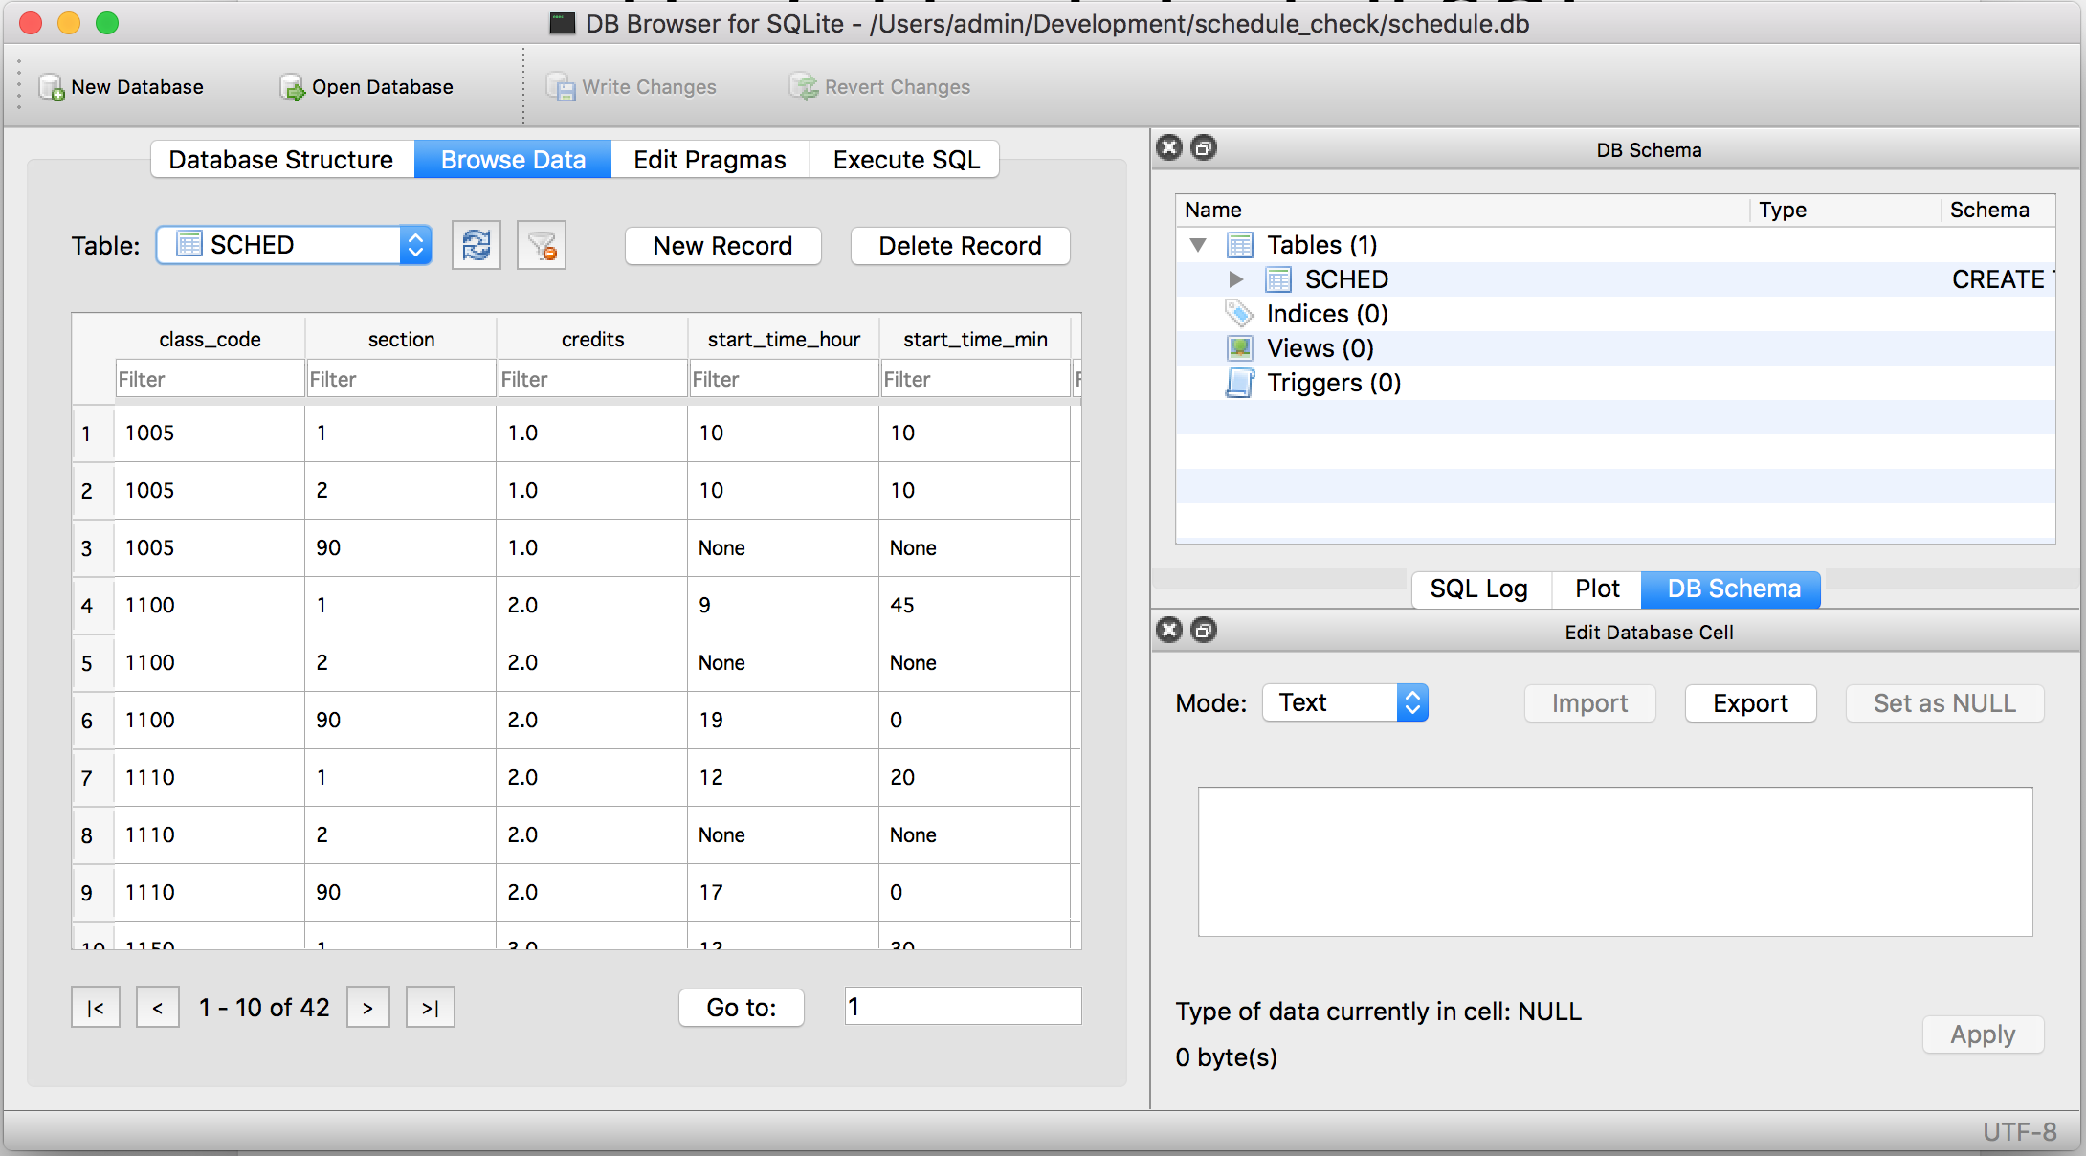
Useful tools for SQLite
Required: sqlite3 shell
Mac/Linux: you probably have the sqlite3 shell application installed
PCs, you'll need to download it, get the sqlite-tools-win32-xxxx.zip from https://sqlite.org/
Unzip to location of your choice
Your own PC: add this location to your path
Lab PC: should be installed already
Optional: GUI database browser
PC/Mac/Linux: http://sqlitebrowser.org/
Similar to MySQL/SQLServer workbench - view, edit, create databases, run queries
OR
Online SQLite browser https://sqliteonline.com/

Slide 6
Example code
https://github.com/claraj/hello_sqlite_python

Slide 7
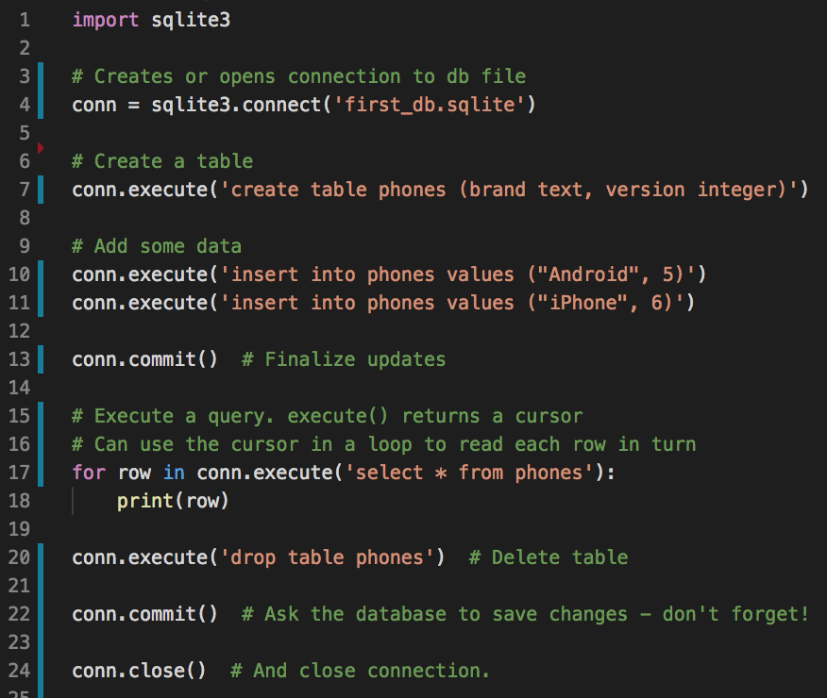
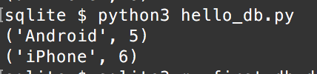
SQLite comes with Python. A simple example hello_db.py
Enter code
Run and test
Expected output:

Slide 8
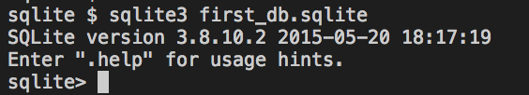
SQLite shell
Comment out the drop table line, line 20
Run the program again
In the command prompt/terminal, use the sqlite3 program to open the first_db.sqlite file created, with this command:
sqlite3 first_db.sqlite

Slide 9
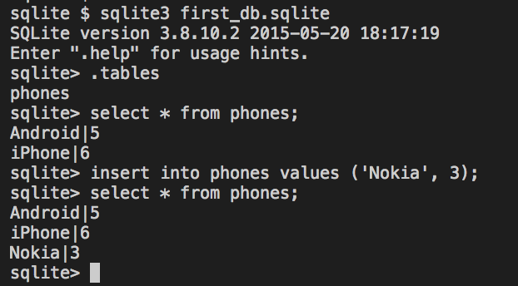
SQLite shell commands
.tables shows all of the tables in the database
.exit to quit
Run SQL queries, add ; at end of query, e.g.
select * from phones;
insert into phones values ('Nokia', 3);

Slide 10
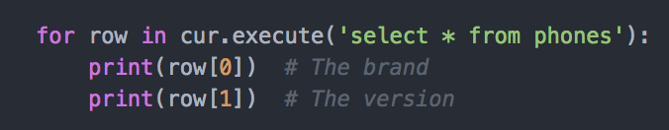
Data from rows
A row behaves like a tuple, so can access data by index
A tuple is a lot like a list, but is immutable - you can't change, add, remove elements

Slide 11
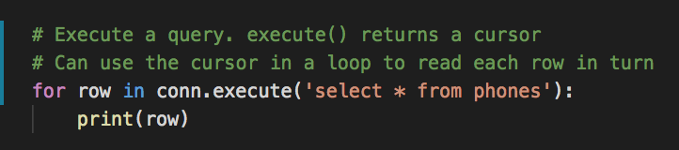

Reading Data
Can use the cursor as an iterator
Each row is a tuple
So row[0] is the first column
row[1] is the second
hello_db_read_cursor.py

Slide 12
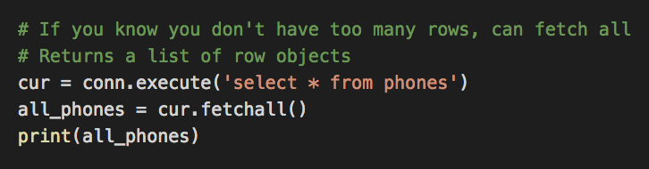
Reading data - fetchall()
Returns a list of rows (as tuples of data)
Hopefully you don't have too much data
What happens if there's more data than memory in your computer?

Slide 13
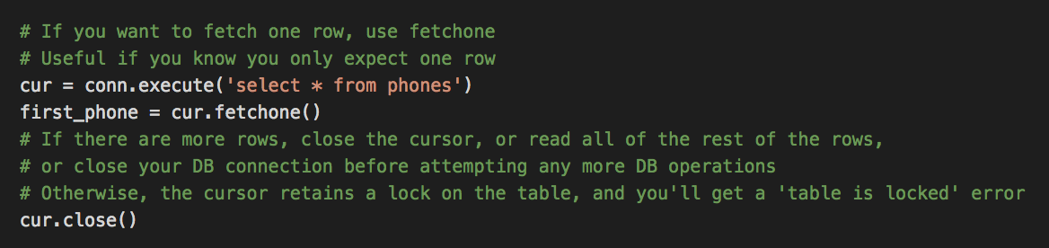
Reading data - fetchone()
If you expect 1 row - for example, you are querying by primary key
Or if you want to check if you have any rows at all - fetchone() returns None if there are no rows

Slide 14
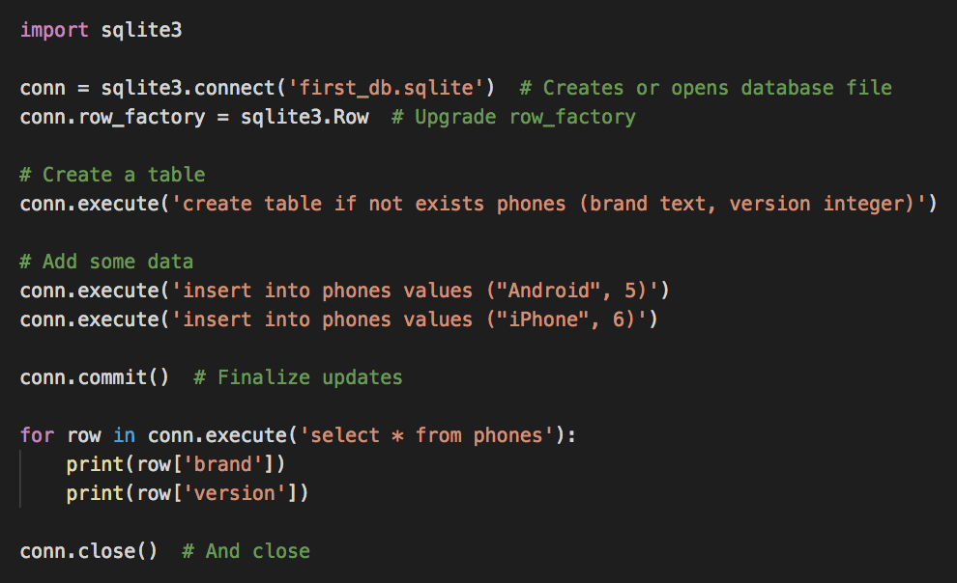
Upgrade row_factory to sqlite3.Row
Permits access by column name - much more readable

Slide 15
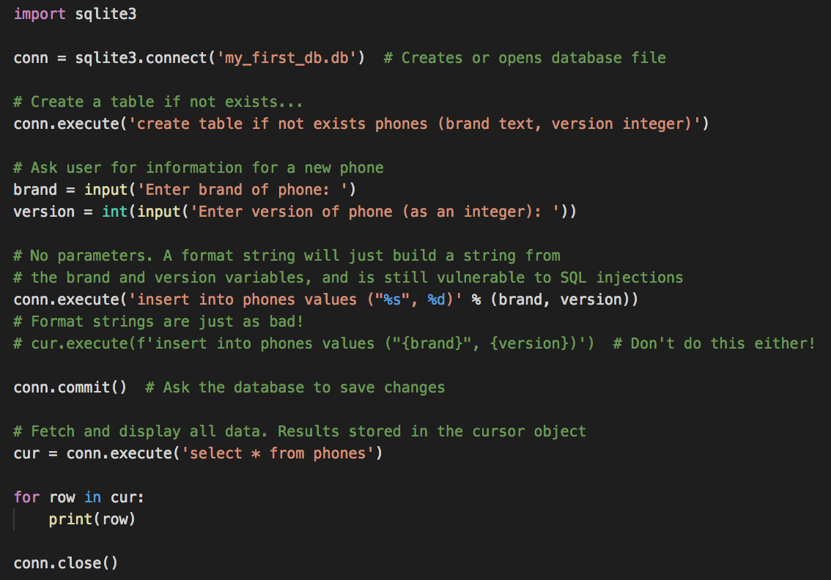
Building database queries – parameters are very important! Especially when using user input
insert_no_param.py
DO NOT USE STRING FORMATTING TO CREATE SQL IN REAL CODE
What is wrong with doing this?
Hint: try this program, and enter "
for the brand of phone
Don't do this either, format strings are just as bad
cur.execute(f'insert into phones values ("{brand}", {version})')

Slide 16
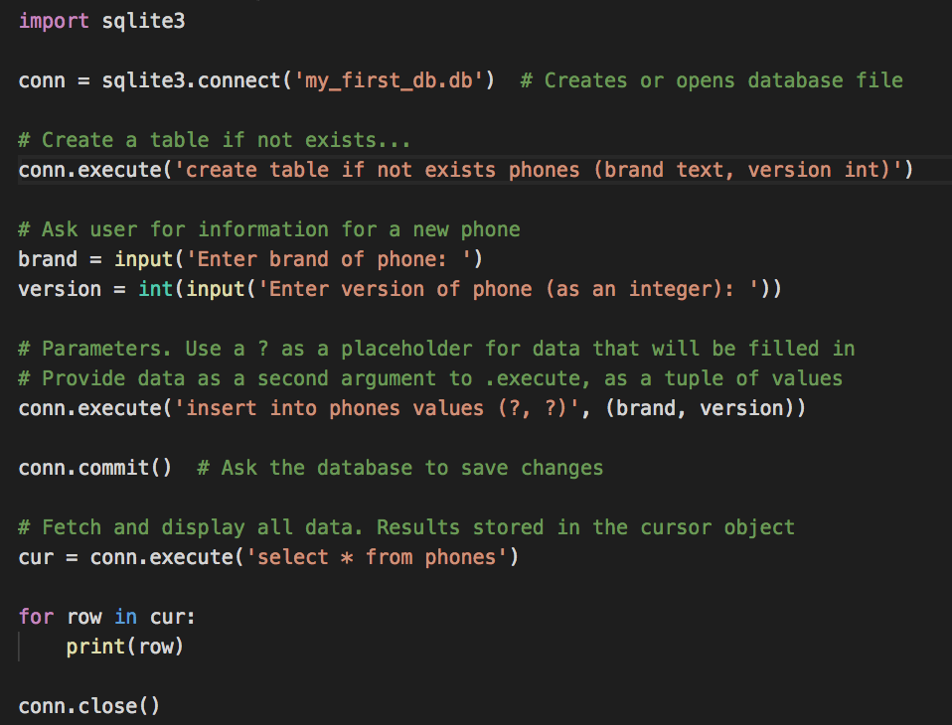
Parameter version
insert_with_param.py
Neater, more legible, and safer
Don't need "" for text values

Slide 17
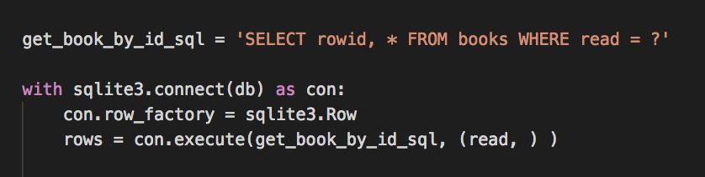
Parameters
Tuple syntax for a single parameter, the trailing comma is require
Example from bookstore

Slide 18
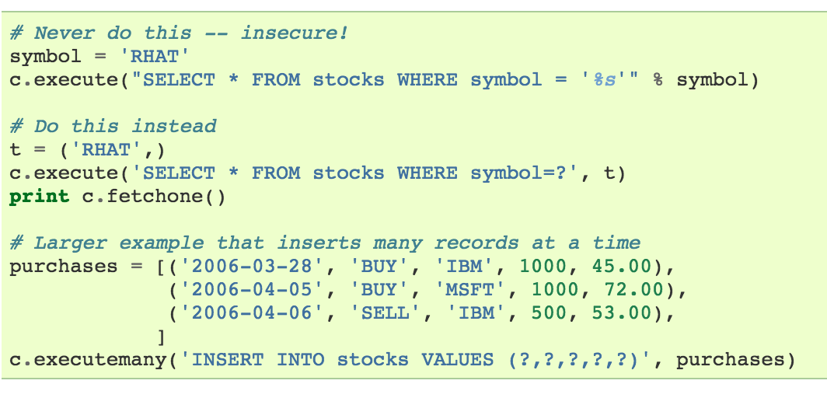
Parameters
Tuple syntax for a single parameter, the trailing comma is required
one_parameter = ( 'data' , )
Can also inserting many records by using the executemany method and providing a list of parameter tuples
Following example from https://docs.python.org/3/library/sqlite3.html

Slide 19
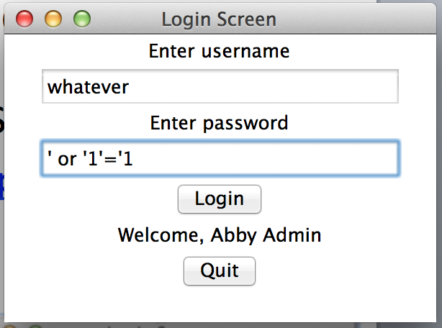
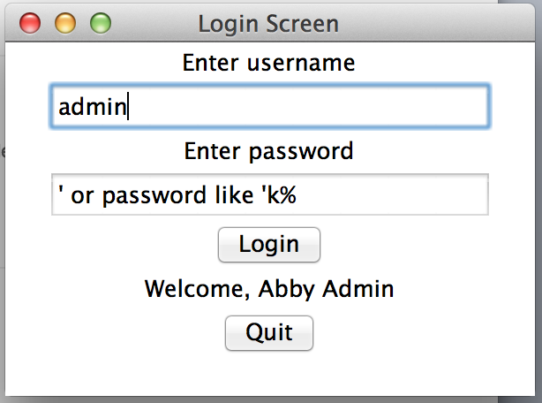
SQL Injection
Login screen vulnerable to SQL injection
https://github.com/claraj/sql_injection
What's happening here?

Slide 20
Handling errors
Types of errors thrown
sqlite3.OperationalError examples: error in SQL syntax, creating table that already exists, table is locked
sqlite3.IntegrityError example: duplicate primary key, violating some constrains
Various others – all subclasses of sqlite3.Error

Slide 21
Handling errors
Use small, logical chunks of code to communicate with db; be prepared to handle errors in each
Examples: Open database, write, close. Open database, read, close. Don't open and leave it open.
How you handle the error depends on your application
Use context manager when modifying database.
If there are any errors, all the changes in the with block will be rolled back so the DB will be in the same state as before the with block
If all the transactions worked, they will be committed
So your database will always be in a predictable state

Slide 22
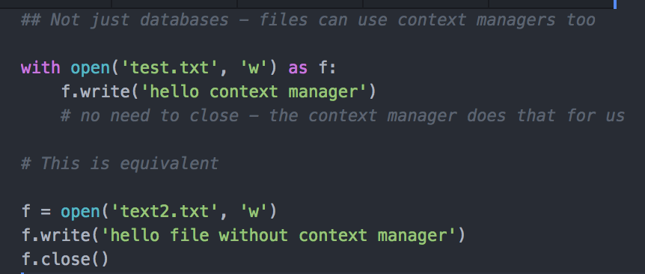
Context Managers
Keyword with
Remember File IO? Example
In this case, the context manager closes the file at the end of the with block, if there is an error, or not

Slide 23
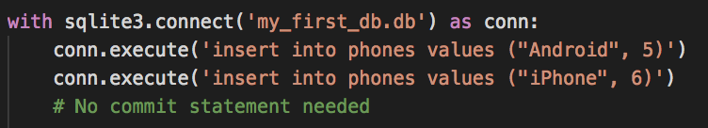
Context Managers
"Connection objects can be used as context managers that automatically commit or rollback transactions. In the event of an exception, the transaction is rolled back; otherwise, the transaction is committed"
https://docs.python.org/3/library/sqlite3.html
If there is an error inside the with block, all transactions carried out in the with block so far will be rolled back. DB will be in the same state as it was before the with block
If there is no error, the transactions will be committed, the changes will be saved to the DB

Slide 24
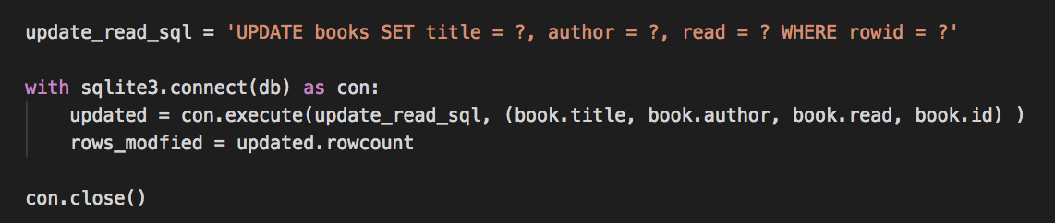
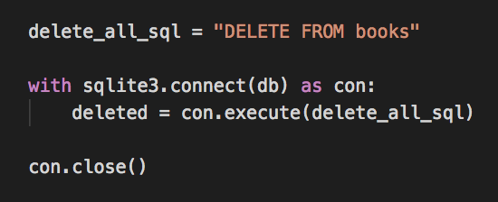
Context Manager Examples

Slide 25
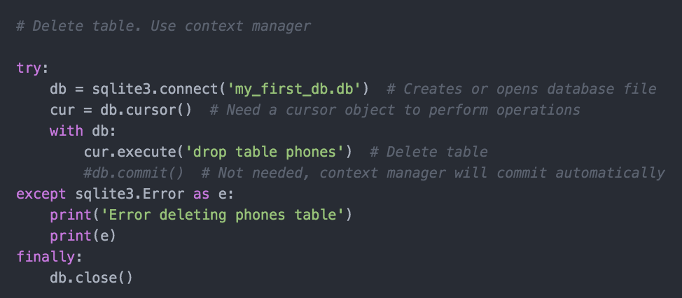
Context Managers + Error Handling
Use for any transaction that modifies the database (update, delete, insert, drop)
Don't need context manager for select queries since the DB is not modified
Context managers don't handle exceptions, you'll still need exception-handling code if exceptions are likely
Exception handling in SQLite is not as critical here as in SQLServer or MySQL; assuming you’ve tested your SQL for correctness. Connection errors, and authentication errors less likely, and only one user so transaction errors less likely too.

Slide 26
Book wish list with SQLite - Project 2
More features
SQLlite automatically generates a rowid column, which is an autoincrementing integer, for any table that doesn't have a primary key. Note that in queries, you have to explicitly select it.
Wrapping and rethrowing exceptions in an except block with the raise BookException('oops') from e syntax, if e is another exception.
The lastrowid attribute of cursors, for knowing what the rowid generated for a new row is after an insert.
The rowcount attribute of cursors, for counting the number of rows affected for a delete or update.

Slide 27
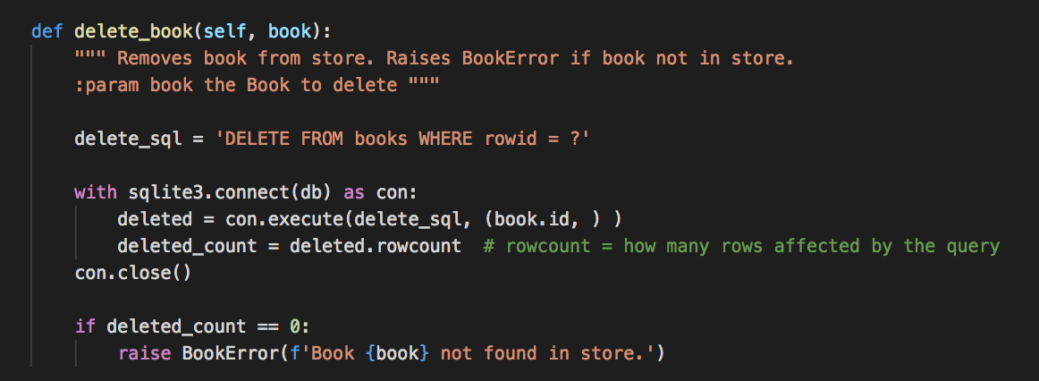
Things to notice: rows modified
Update, insert, and delete queries provide the number of rows modified in the cursor as the row_count attribute
So, don't need to check if book is there before deleting
Just delete, and verify the number of rows deleted matches expected value
Can use similar strategy with updates, inserts

Slide 28
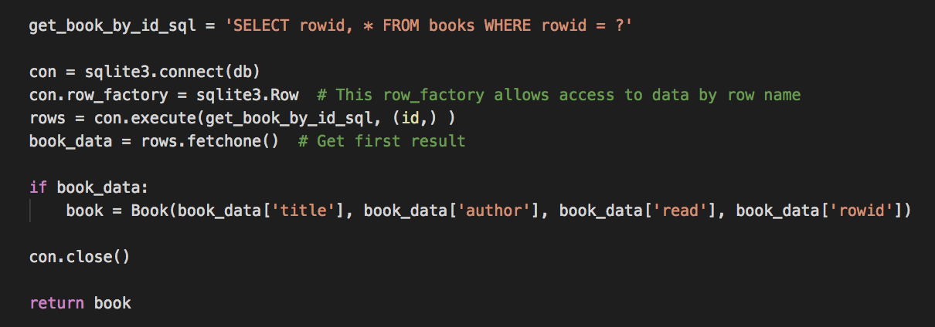
Things to notice: auto rowid column
SQLite automatically generates a rowid column, an autoincrementing integer
So you get a free primary key column
Other databases don't do this, have to specify your PK column
Can use rowid column in queries
Have to include rowid in select column names or it is not included

Slide 29
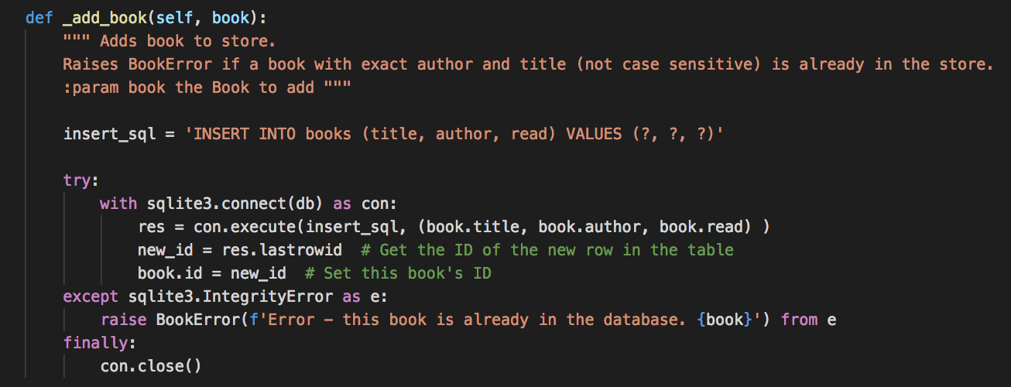
Things to notice: auto rowid column
After an insert statements, the cursor knows the autogenerated rowid value
lastrowid attribute

Slide 30
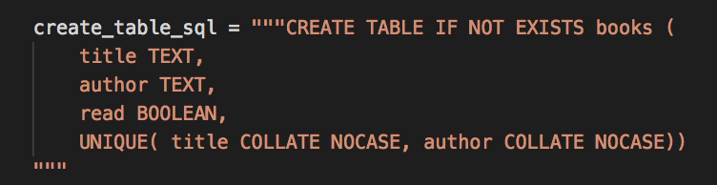
Things to notice - database constraints
Can specify constraints when creating database tables
Unique constraints, values within a range, values must be from a set of values, value must match a pattern...
Recommended - if the database can refuse invalid data, you can use it to check for invalid data, or have a safety net for checks the program does
Checking for unique author-title combinations

Slide 31
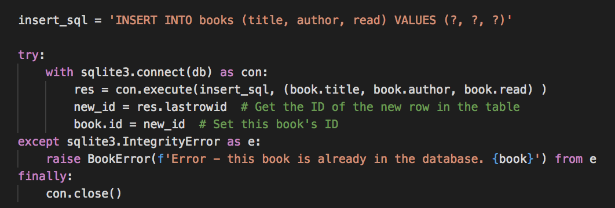
Similar strategy to before - attempt to insert then:
If constraint met, insert works
If constraint violated, catch error, report
If constraint met: faster than a select query to check is in DB, followed by an insert
Exception handling is (sometimes) slower than two queries but we generally expect inserts to work more times than not
Also, for a MySQL/SQLServer database, no opportunity for the DB to be modified between the check and the insert

Slide 32
Things to notice
Converting Python objects to DB table rows
The Book class has the same attributes as DB column names
This is a really common pattern in code
So next DB application you write, you'll most likely have objects that map to DB table column names
We'll look into a way of saving some work while doing this next

Slide 33
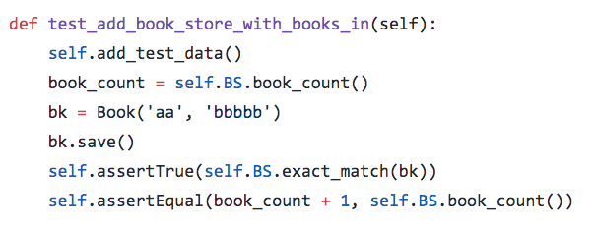
Testing a database
Not much different to testing other code
Arrange - set up scenario
Action - call DB function
Assert - check all is as expected
Test from readinglist
Which line(s) are for which AAA steps?

Slide 34
Testing a database
Tests should start in a known state
Tests should not modify production data
Real data the app, customers use
So, tests should not use the real database
Tests should have a duplicate database with the same structure as the real database
Typically, the tests run with an empty database, and may add example data

Slide 35
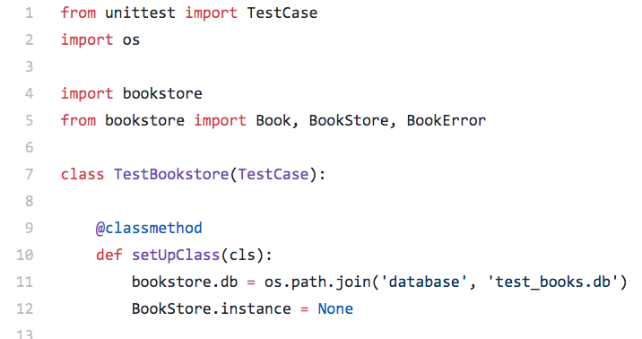
Replace real database with test database for testing
readinglist - replacing Bookstore's db with a test database

Slide 36
Your turn
Start with the milesdb program in hello_python_unittest repository
https://github.com/claraj/hello_python_unittest/tree/master/miles_db

Slide 37
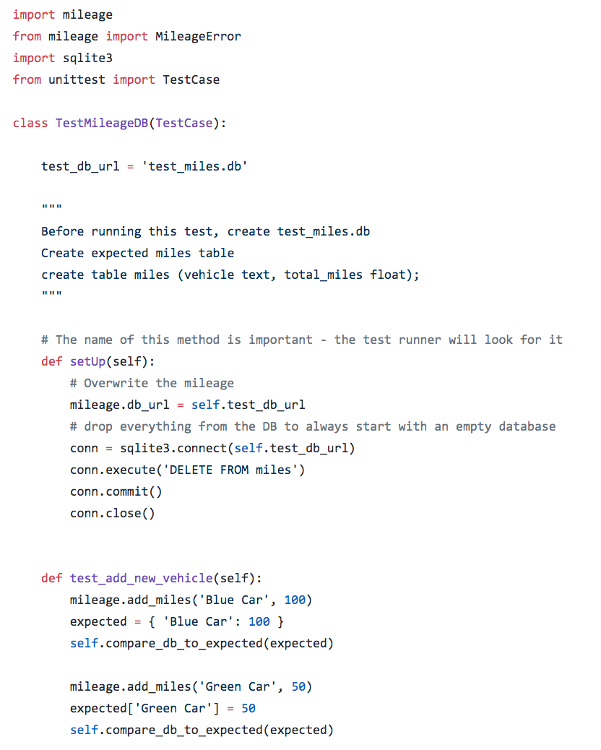
test_mileage.py
test database filename
setUp is a name recognized by the test runner. The setUp method will be called before every test

Slide 38
test_mileage.py
test database filename
setUp used to substitute a test database, in place of the application's real database
And delete everything from the test database, so the tests will always start in the same state

Slide 39
Your turn: milesdb
The requirements have changed to require that all the vehicle names are stored in uppercase. When a user enters a vehicle, e.g. 'Blue Car', it will be saved in the database as 'BLUE CAR'. If the user wants to update this vehicle, they should be able to enter 'Blue Car' or 'bLuE cAr' or 'BLUE CAR' and the intended vehicle will be updated.
Modify mileage.py to support this feature.
Write test(s) to confirm correct functionality.
Verify that your tests use the test database, and don't affect the data in the main mileage.db database.

Slide 40
References/Useful Resources/Examples
Official Python reference https://docs.python.org/3.7/library/sqlite3.html
SQLite reference https://www.sqlite.org/lang.html
Pretty comprehensive SQLite walkthrough http://sebastianraschka.com/Articles/2014_sqlite_in_python_tutorial.html
Another, from PythonCentral http://pythoncentral.io/introduction-to-sqlite-in-python/

Slide 41
ORM - Object Relational Mapper
Several available: for Python, Peewee or SQLAlchemy
Almost all web application frameworks provide an ORM, including Django (later this semester)
C# Entity framework
Java Hibernate
Many others

Slide 42
ORM: Object-Relational Mapping
In your previous code-database interactions, have you ever read a row from a database, and turn the info in that row into an object?
Or made changes to that object, and needed to save the change back to the DB?
Probably, many times, right? Rows in a database turned into objects in a program
And objects in your program saved to a database row
Or querying the database, making the results into a list of objects

Slide 43
ORM: Object-Relational Mapping
Very, very common pattern; so ORM - object-relational mapping - packages provide a purely programmatic way to interact with databases
Define the fields of your objects; which maps to the structure of rows in your database
Can request a list of objects - DB is queried and object/list of objects is returned
Can create an object, and it can be saved to the DB
Can manipulate objects, and updates are saved to DB
Note that with ORM, you still need a database program – The ORM does not replace your database – the ORM just helps your code talk to your database

Slide 44
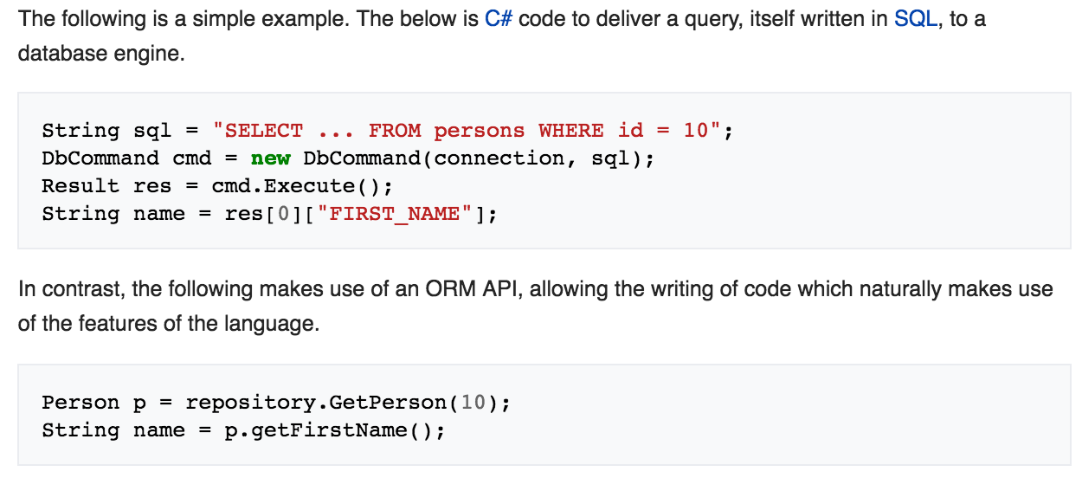
C# Example Code; Entity Framework
https://en.wikipedia.org/wiki/Object-relational_mapping

Slide 45
ORM Pros and Cons
Pros:
Simplifies code
Programmers don't need to write SQL statements
Build-in parameterization – data is treated as data, makes SQL injection harder
ORM may cache query results for duplicate queries, and only use the database if the data is known to have changed
Lazy queries - only actually do the work when the data is used
Cons:
May be slower than native DB queries, especially for complex queries
Another dependency
Many not be an ORM for your database and your programming language; difficulties in migrating from one DB to another
Harder to debug
May be difficult to create complex queries
Although most ORMs permit you to write SQL statements if needed
Programmers 'hide' from DB, limiting their understanding of how it works

Slide 46
Common ORM packages
Java: Hibernate, Enterprise Java Beans (EJB)
C# - Entity Framework
Python: peewee, SQLAlchemy, Django*
iOS - Core Data
Android - Sugar, Room
JavaScript - Mongoose, Seqelize
Many others; most programming languages and web frameworks have at least one ORM package
*We'll cover when we look at web application frameworks

Slide 47
Peewee
http://docs.peewee-orm.com
Has many features - we'll focus on the basics
Start new project
From the terminal/command prompt, install PeeWee with pip by typing
PCs
pip install peewee
Macs
pip3 install peewee
Lab computers
pip install --user peewee
Please note the correct version for your computer. For all future instructions to use a pip install command, use the correct version for your computer

Slide 48
Mapping
Peewee maps Python objects to rows in a table of a database
A session object manages these mappings
Create Python class that defines the mapped object; and the schema of the table that these objects will be stored in
One table; one Python class
E.g. the rows in a students table (name, email, id) could be mapped to python Student objects (which will have name, email, id fields)

Slide 49
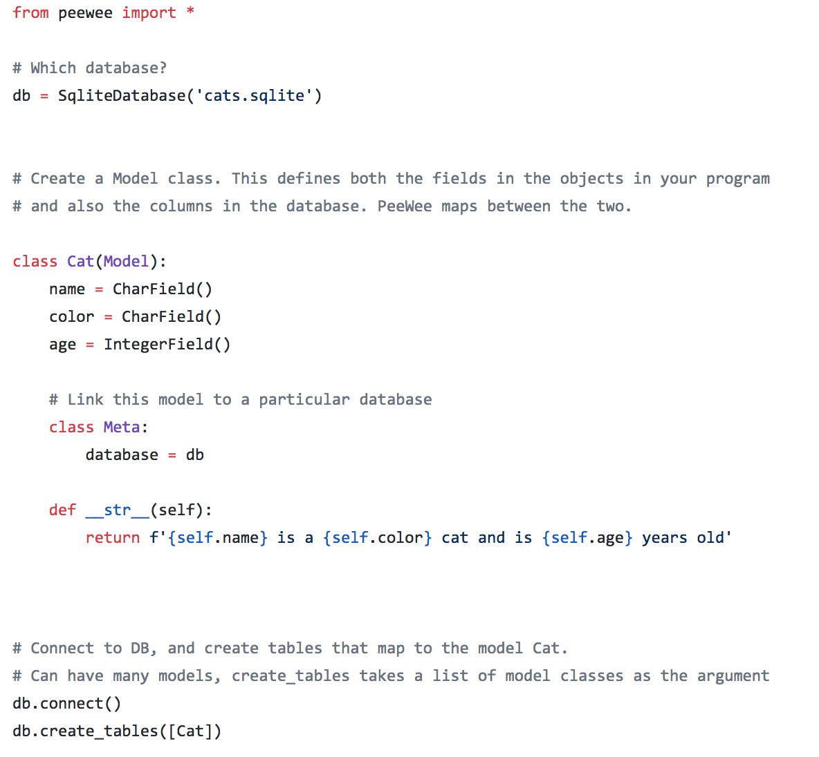
Create a file called cat.py Create a Cat model Can you see the fields that will become database columns?

Slide 50
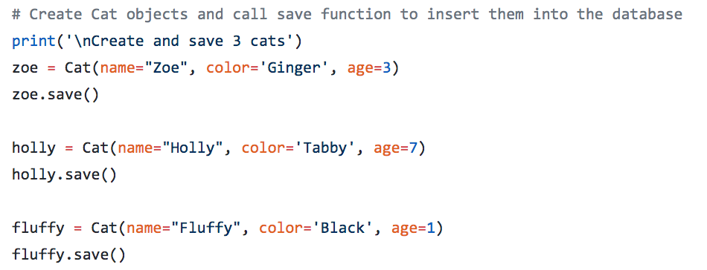
cat.py, continued - add this code next
Create some Cat objects, and call the save method
You have to specify column names using named parameters

Slide 51
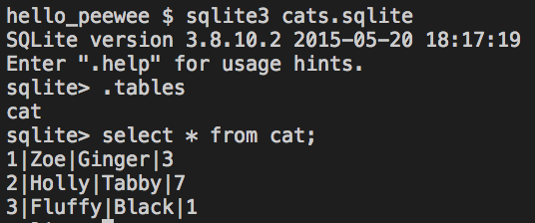
Open your database
Note the table name is the same as your class
sqlite3 cat.sqlite
select * from cat;
Verify data
in database

Slide 52
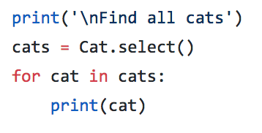
cat.py continued - add this code
select() returns a query object you can loop over, or turn into a list, for example
list_of_cats = list(cats)

Slide 53
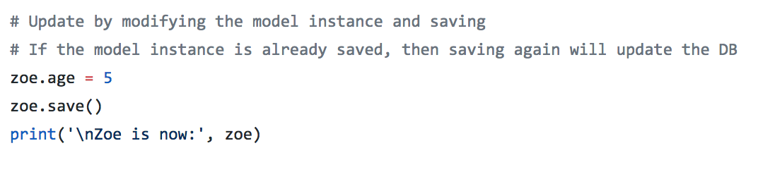
Updates - if you have a model instance already
Update the age of a Cat
Run this code, and verify in the sqlite shell

Slide 54
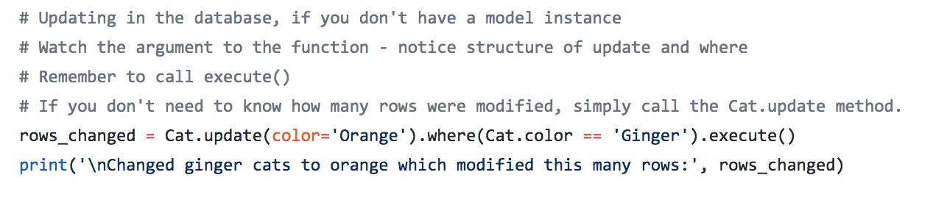
Updating directly, no model instance
Don't need a model instance
Note you need to call execute() on update queries to modify the database

Slide 55
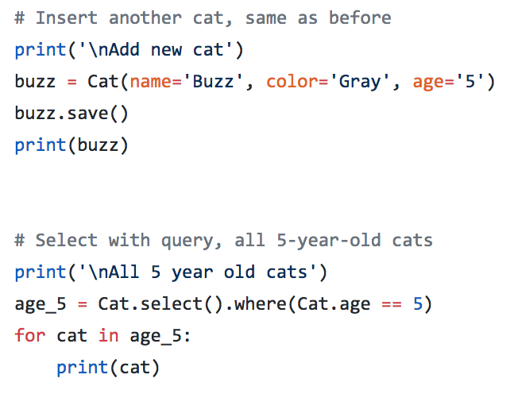
More queries
Insert another cat
Now try a query with a where clause
Look at the argument to the where method

Slide 56
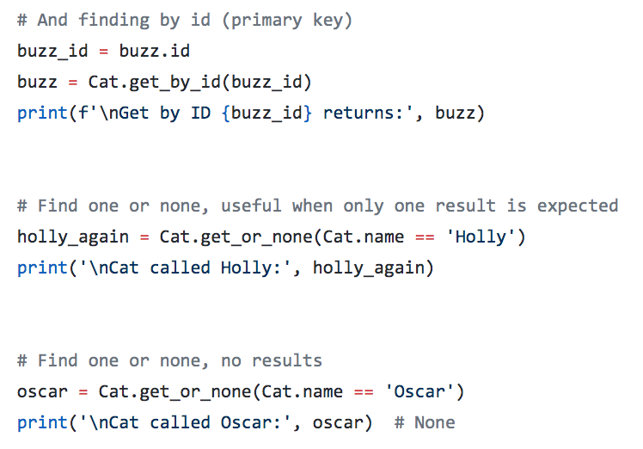
Find one, find by ID
find_by_id raises an error if id not found

Slide 57
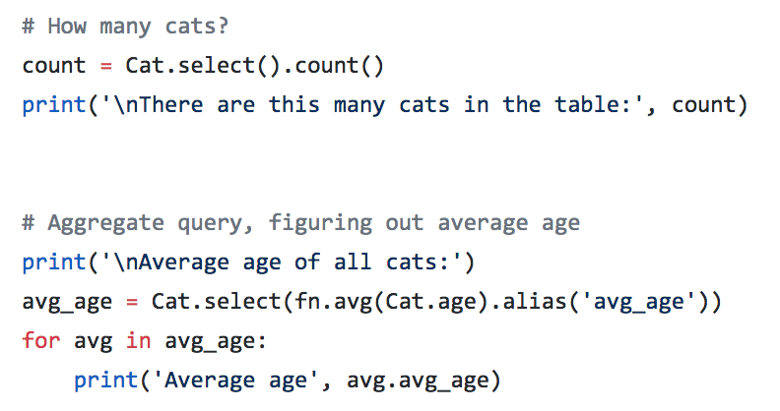
Aggregate queries
Convenient shortcut for count
Other aggregates use fn parameters

Slide 58
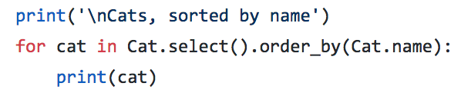
Sorting
Append order_by()

Slide 59
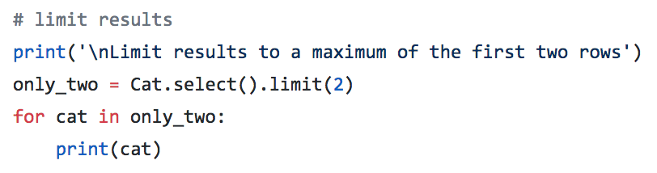
Limiting
Common to only want the first rows returned from a query
Total matching results might be a very large number, so if you don't need them all, don't fetch them

Slide 60
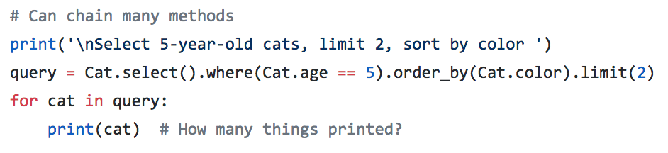
Limiting
Can chain order_by, limit, and other methods to filter the results
example: social media app may fetch the most recent 20 posts
most_recent = Post.select().order_by(Post.date).limit(20)

Slide 61
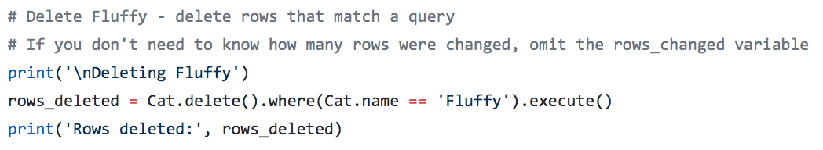
Deleting
Delete rows that match a query
Note you need to execute() your query to modify the database

Slide 62
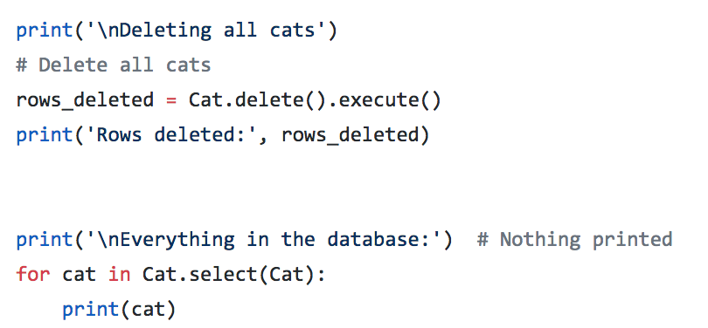
Delete all
Delete with no where deletes everything!

Slide 63
Relationships between tables
Foreign key relationships are supported
If one column is a foreign key for another table, when Peewee maps the DB to that object, it can populate the object with data from the item the foreign key refers to
E.g. A users table and phones table. A phone can be assigned to a user; so phone table has a column for user id; this is a foreign key
Peewee can create phone objects and include the user's data in the object

Slide 64
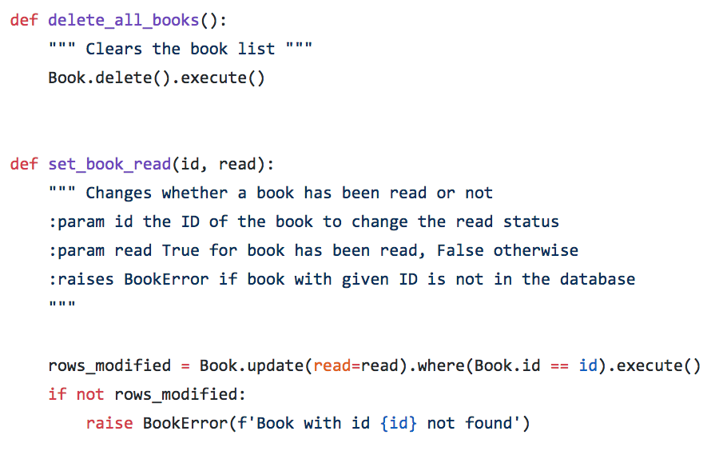
Book Reading List- Peewee version
In the example repo peewee_orm/reading_list
Much shorter code - less than half the lines!
Part of bookstore.py

Slide 65
ORM vs SQL
Review: pros and cons of Peewee plus database; vs talking directly to your database with regular database queries
More initial setup; complex queries are more work, less efficient may need to fall back to SQL
But can simplify code considerably, adds validation and checks for SQL injection

Slide 66
Lab
Lab:
Create a database program with SQLite
And then, make a copy, and use Peewee for the same program
Hacker time! SQL injection*
Start Project 3: art inventory manager
*Not really. Don't hack things in real life please.

